Slide 1
Project 2
UC Berkeley
Health Monitor
User Interface

Slide 2
Idea
Create a web application to control various health indicators and medications efficiency.
Basic functionality:
Authentification: a possibility to create a user’s account and logging in to our website;
Summary Health: a possibility to keep information about all medications that our user is taking (names, doses, schedule for taking medications) and to download basic information (e.g. main side effects, drug interactions, composition, rules for taking of these medications, etc.) about these medications from different DBs (or APIs);
User’s Indicators Control
Calendar: a possibility to choose a date to put the information related to some indicators;
Alerts: to send alert emails to take medications and to fill the information in our website;
Visualization: to create some graphs for indicators monitoring (indicators dynamics, etc.).

Slide 3
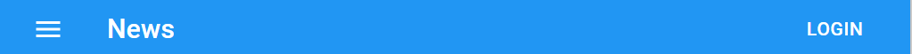
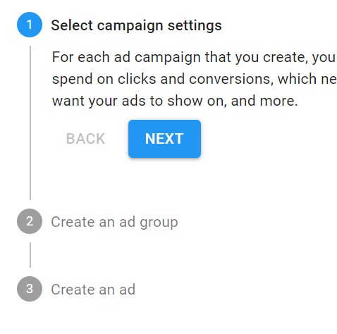
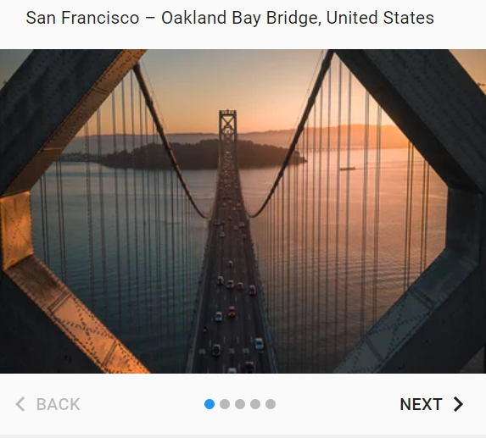
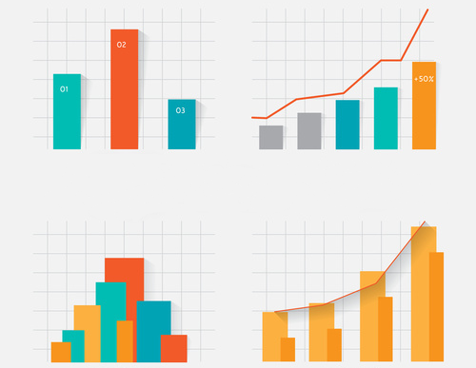
Health Monitoring App
If user press this button he/she will see the authentication page (see slide 4)
Sign In or Sign Up
Just enter your username and password
or press Sign Up and follow further instructions
You can visualize your feelings
Main Information about the App with some pictures (examples of graphs, reports, etc.)
Tell Us About Yourself
Add Your Indicators
A Simple Guide with Info for the users:
Sign In or Sign Up
Tell us About You (name, age, sex, etc.)
Add your indicators to monitor

Slide 4
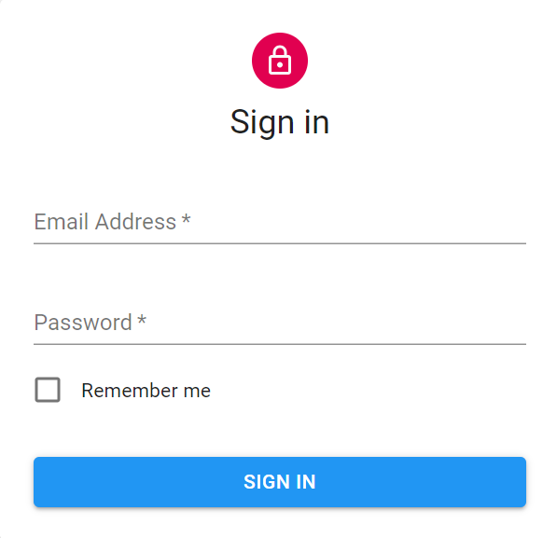

Health Monitoring App
User should enter the data to sign in or press sign up button to register and “Forgot Password” button to send the data to their email (registration page see on slide 5, password reminder - slide 8)
Forgot Password
SIGN UP

Slide 5
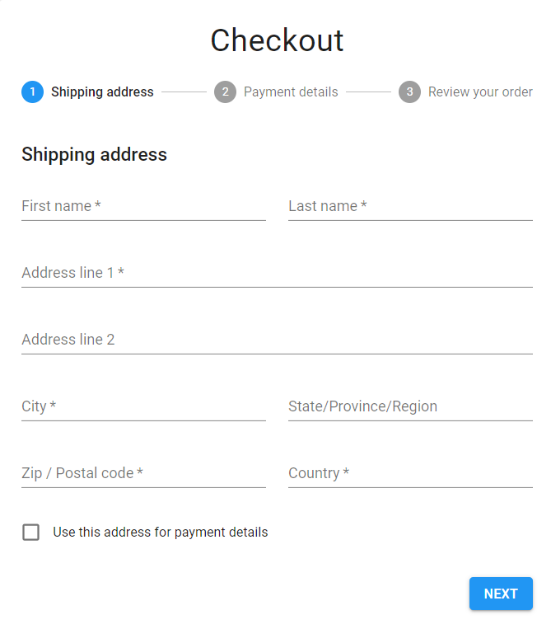
Health Monitoring App
Registration
Basics
Health Summary
Your Indicators
Age, sex, weight and height are mandatory fields, because they are connected to the medicines blood concentration and influence on other factors
Personal Data
Username *
Name
Age *
Sex *
User must enter his/her basic info: username, age, sex, weight, height, etc.
Weight *
Height *
City
Country

Slide 6



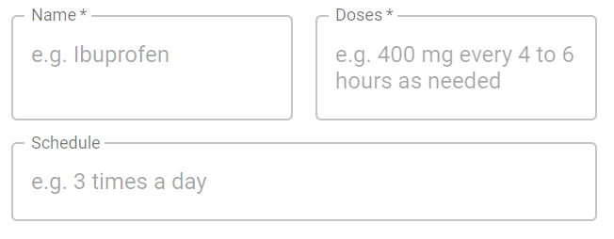

Health Monitoring App
Registration
1
Basics
2
Health Summary
Your Indicators
Diagnoses
Username *
Name
User must enter the basic data about his/her health: main health issues (diagnoses, info about medications)
Age *
Sex *
Medications
Weight *
Height *
City
Country

Slide 7
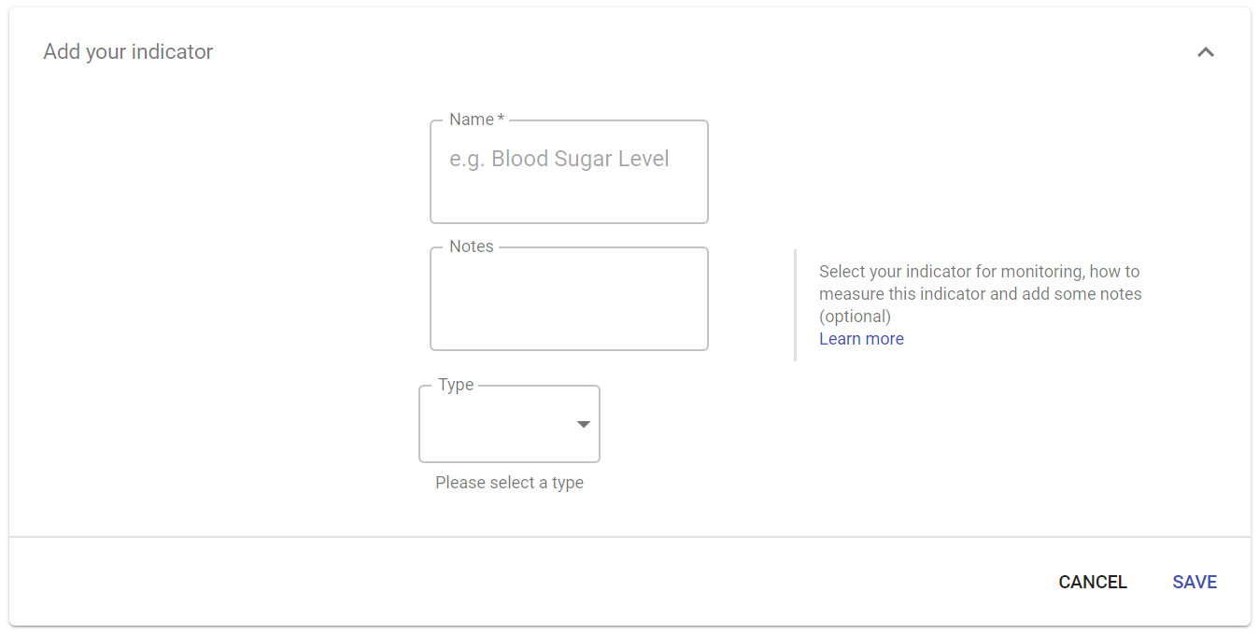

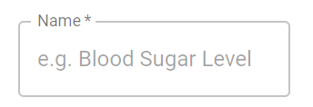
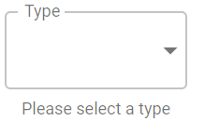


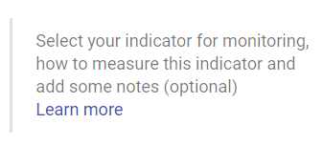
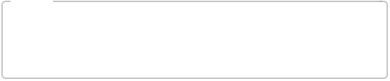

Health Monitoring App
Registration
1
Basics
2
Health Summary
3
Your Indicators
Indicators
Username *
Name
Age *
Sex *
User must enter at least one indicator to monitor: indicator name, indicator type, notes about indicator (optional)
Weight *
Height *
City
Country
FINISH

Slide 8

Health Monitoring App
SIGN IN OR SIGN UP
Reset Password
New Password *
Confirm Password *
SEND

Slide 9
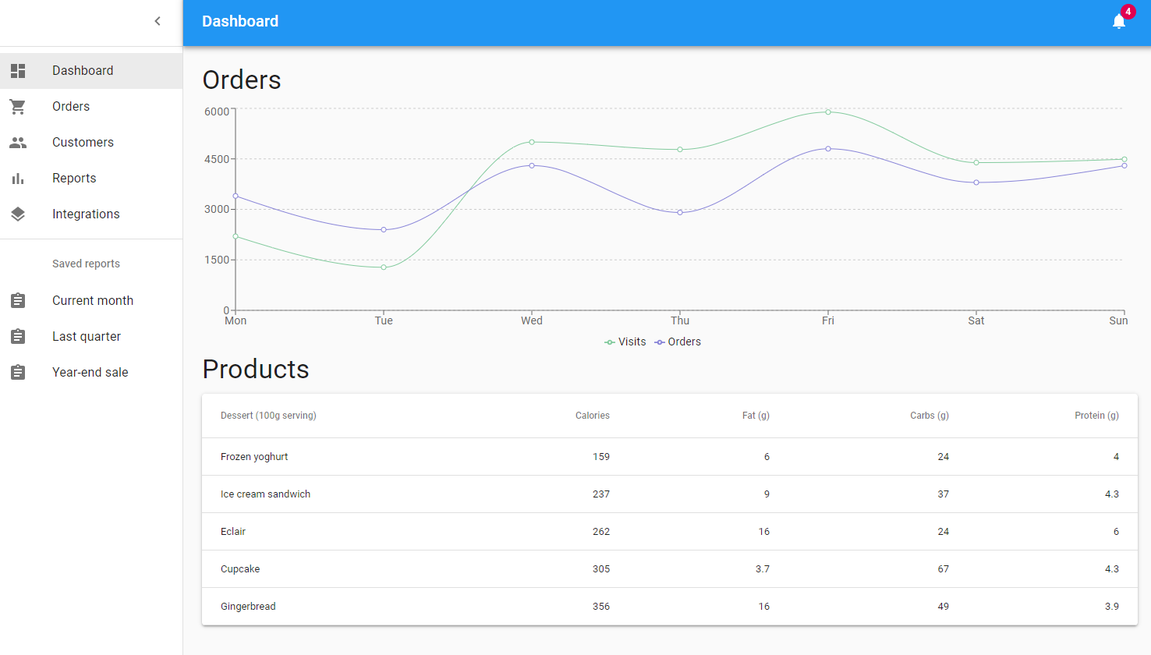




LOG OUT
Dashboard
Blood Sugar Level
Button to select existing indicator
Reports
Medications
Indicators
Interaction
Interactions
Details
The main window of the authorized user, blood sugar level monitoring is just example of indicator, user must press Indicators button or Add New Data

Slide 10
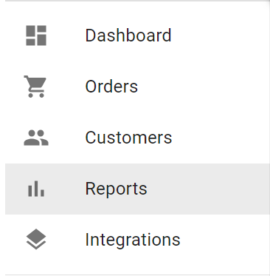

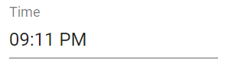

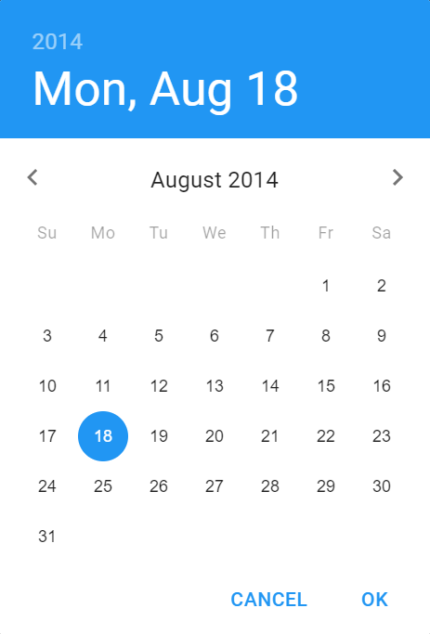
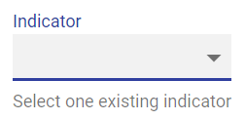
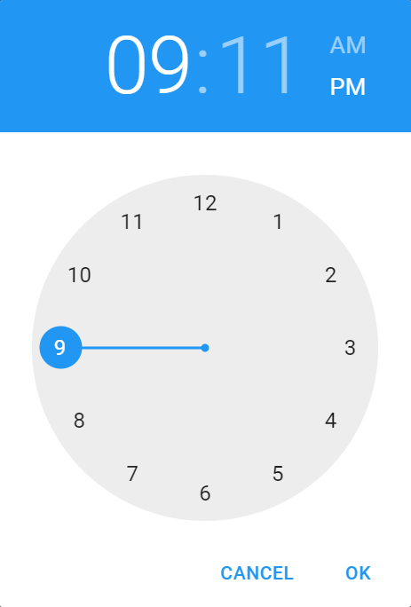
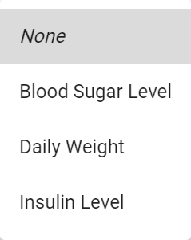
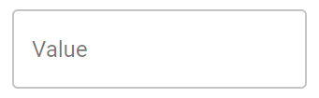
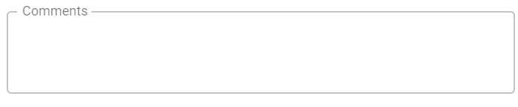

LOG OUT
Dashboard
Enter Daily Data
Reports
Indicators
Medications
Medications
Indicators
Interactions
Details
After click on this button the form from slide 7 opens
The window for daily filling the data according to the indicator

